Slide 1
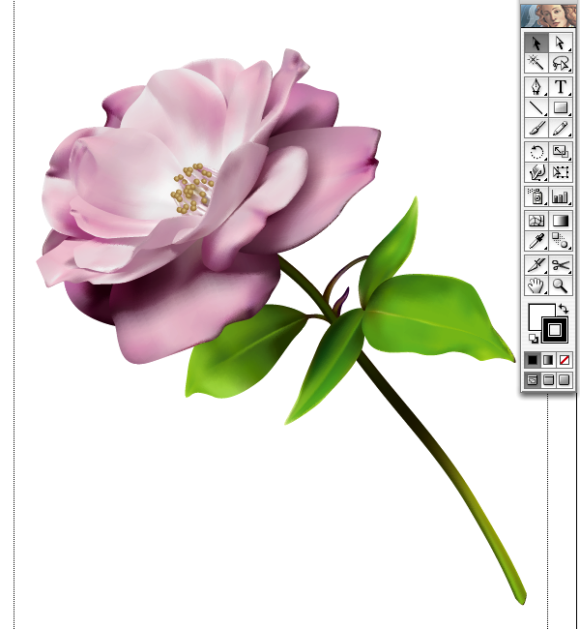
2-D COMPUTER GRAPHICS
BITMAPPED IMAGES &
VECTOR DRAWN GRAPHICS

Slide 2
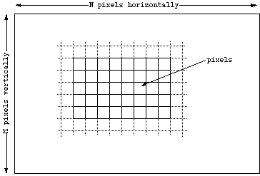
BITMAPPED GRAPHICS
Bitmapped graphics
Created as a pattern of discrete elements called pixels or "picture elements."
Pixels
Small squares.
Assigned a binary code to define color.
More bits = more color possibilities
Note that bitmaps are always orientated horizontally and vertically.
Notes:
Students may identify the square elements that are part of the cat's image.
2 bit color code would yield 4 colors, 8 bit code yields 256 colors. Have students consider what 1, 16, 24 bit codes would generate for color ranges.

Slide 3
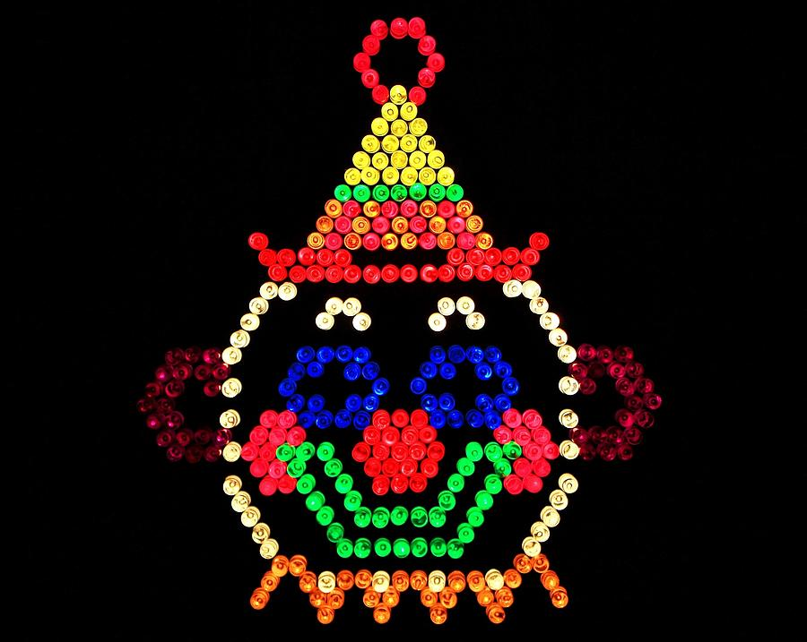

Slide 4
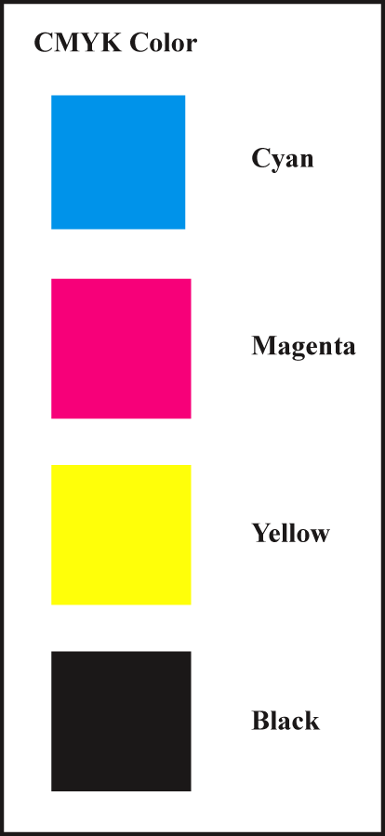
TRADITIONAL GRAPHICS
Color image reproduction.
Use a series of four-color dots of transparent inks.
CYMK
Cyan, magenta, yellow, and a key color usually black.
Small dots of color combinations can reproduce many different colors.
Notes:
Review the distinction between additive and subtractive color and why this is important for computer graphics artists who create projects for printed output.

Slide 5
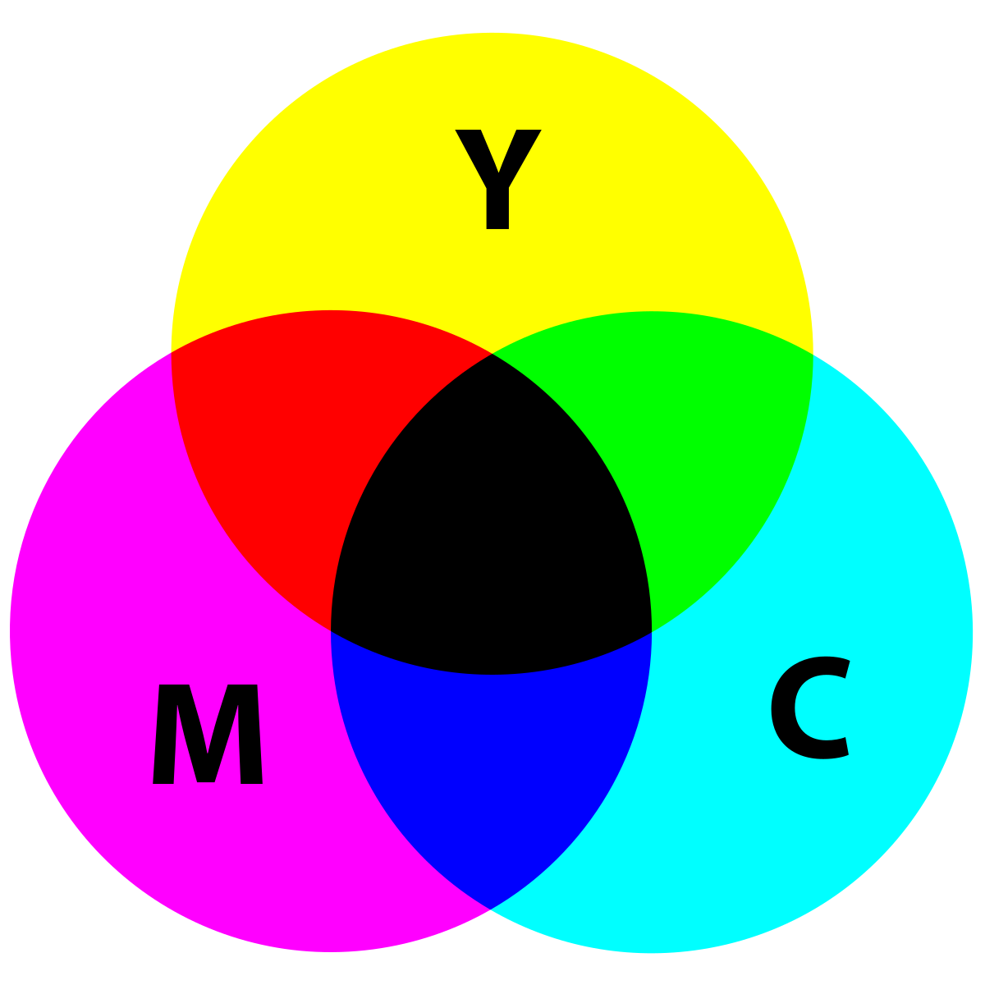
COLOR REPRODUCTION
Color images on printed surface are formed using subtractive process.
Light is reflected from the printed surface.
Pigments that form an image absorb some of the colors.
Remaining colors reach the eye to produce image.

Slide 6
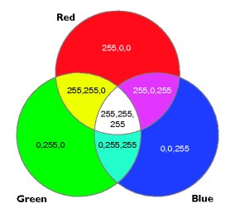
Color images on computer monitor use additive process.
Varying amounts of Red, Green, and Blue light are added together to create the color.
Graphic artists convert from RGB(additive) color models to CMYK model if image is printed.

Slide 7
BITMAPPED IMAGES
Categories of bitmapped images are:
Line art
Produced using two colors.
Grayscale
Produced using shades of gray.
Color
Produced with patterns of colored pixels.

Slide 8
BITMAPPED IMAGES
Line art
Two colors, usually black and white.
Advantages
Clear, crisp image.
Small file size.
Uses include:
Charts
Illustrations
Diagrams.
Line art is
1-bit color
Line art flow chart diagram

Slide 9
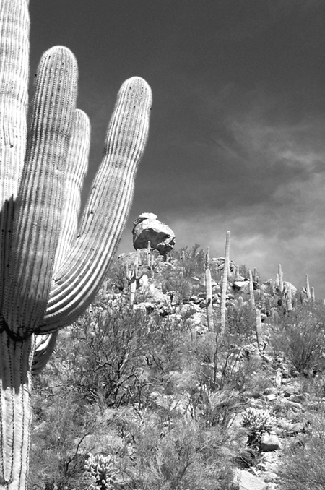
BITMAPPED IMAGES
Grayscale
Generally 8-bit images of 256 shades of gray
For images that require more detail than line art.
Advantages
Excellent representation of black and white photos
Smaller files size than full color
Lower printing costs than color.

Slide 10
BITMAPPED IMAGES
Color
Consists of a pattern of colored pixels
Bit depth: the number of bits used to encode each pixel determines the amount of color possibilities.
Photo-realistic color requires 24-bit color.
Two methods to create color on a computer:
Identify a table of possible colors for the computer (Color Lookup Table)
Specify varying amounts of Red, Green, Blue.

Slide 11
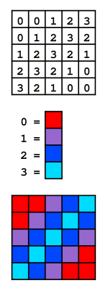
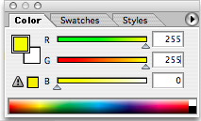
MAKING COMPUTER COLOR
8-bit color presents a specific range of colors in a table.
PCs and Macs use different tables.
Web-safe table provides colors that display the same on all platforms.
24-bit color combines 8-bit values of red, green, or blue to create the result.
16.7 million color possibilities.
Notes:
Discuss uses of 8, 24, 48 bit color models and the advantages and disadvantages of each.
Web safe colors limit the range to 216 possibilities. Discuss the relevance of using web safe palettes for current computer displays.
CC BY-SA 3.0, https://commons.wikimedia.org/w/index.php?curid=189935

Slide 12
BITMAPPED IMAGE QUALITY
Image quality depends on spatial and color resolution.
Spatial resolution = density of pixels per inch.
Color resolution = number of colors each pixel can display.
Spatial resolution measurements.
Monitor output is measured in ppi (pixels per inch).
Print output is measured as dpi (dots per inch).

Slide 13
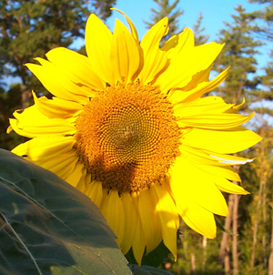

SPATIAL RESOLUTION
Higher spatial resolution
Captures more detail.
Pixels are smaller and closely packed.
Produces sharper, more accurate images.
Lower spatial resolution
Captures less detail.
Pixels are larger.
Images appear fuzzy.
High spatial resolutions yield large file sizes but better image quality.

Slide 14
DEVICE-DEPENDENCE
Dimensions of an image depend on the resolution of the output device.
Monitors have low spatial resolution:
72 ppi (Mac) or 96 ppi (PC).
Printers/phones/tablets have higher spatial resolutions:
300 dpi to 2400 dpi.
Bitmapped images are device-dependent.
300 ppi image prints the original size on 300 dpi printer.
Same image is greatly enlarged on a 72 ppi monitor.
Notes:
Relate this concept to images from digital cameras. The photo may print on a 4 X 6 dimension, but on a monitor it will fill the screen to overflow the edges.
Consider the practice of producing bitmapped images in several spatial resolutions to match the intended output. Web images are typically 72 ppi, but color laser printer images would start at 300 ppi.

Slide 15

COLOR RESOLUTION
Bit-depth determines color resolution.
Making the bit-depth choice:
Simple color images do not require many colors. Low bit-depth yields small file size.
Complex color images require millions of colors. High bit-depth yields better quality but larger files.
Low color resolution may cause quantization and color banding.
Quantization leads to breaks in shades of continuous tone images.
Notes:
Quantization will round off the missing color codes to the nearest available code. This may cause colors to band rather than transition smoothly to the next shade.

Slide 16
COLOR RESOLUTION
Indexing
A specific palette of colors is identified to optimize the appearance of lower color resolution image.
Dithering
Combining pixels of different colors to produce another color not available in the indexed palette.
Improves image quality without increasing bit depth.
Notes:
Discuss how developers can use indexing to reduce file size.

Slide 17
BITMAPPED FILE FORMATS
Compression of bitmapped graphics are:
Lossy
Lossless.
Common graphic file formats are:
PICT
BMP
TIFF
JPEG
GIF
PNG
What form of compression do each of these formats use?
Notes:
Review special features of these file formats.
Have students suggest other file formats for images, some may be software specific such as .psd from Photoshop.
Identify which formats are lossy and which are lossless.

Slide 18
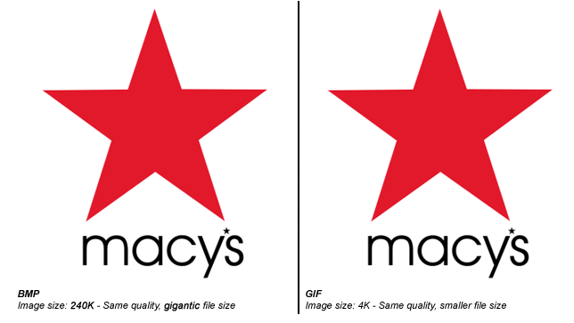
BMP vs GIF

Slide 19
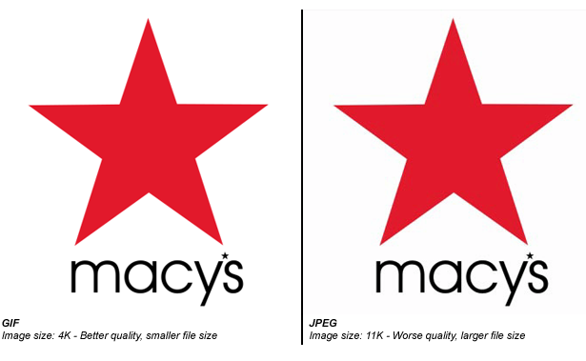
GIF vs JPEG

Slide 20
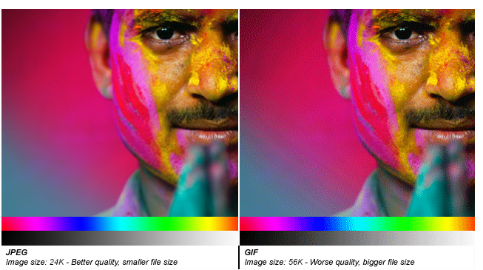
JPEG vs GIF

Slide 21
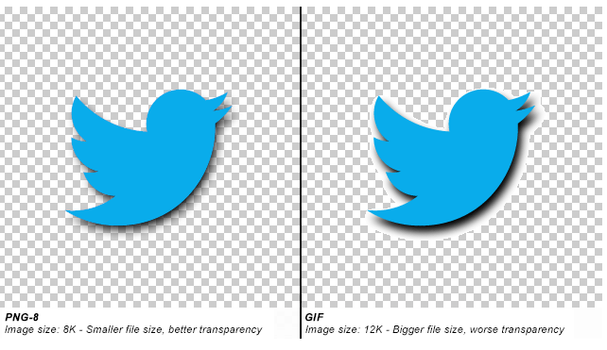
PNG vs GIF

Slide 22
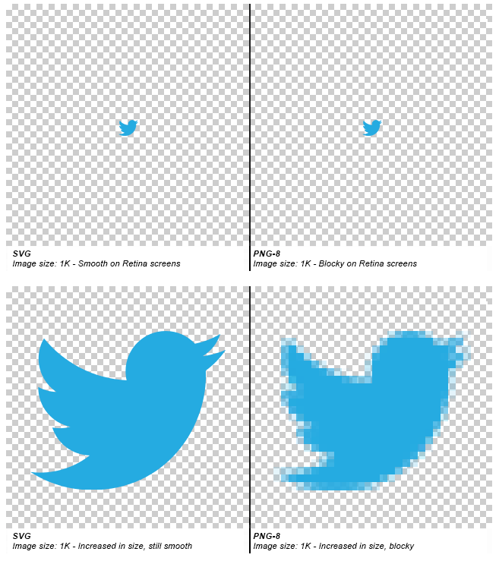
SVG Scalable Vector Graphic

Slide 23
VECTOR-DRAWN GRAPHICS
Vector: a line with length, curvature, and direction.
Vector graphics: images created from mathematically defined shapes.
Draw programs: software used to create vector graphics.
Main advantages:
Images can be enlarged without distortion
Small file size.

Slide 24
How vector drawn images work
A vector is a line that is described by the location of its two endpoints.
Vector drawing makes use of Cartesian coordinates.
Cartesian coordinates are numbers that describe a point in two or three dimensional space as the intersection of the X, Y, and Z axes.
L1 [ <0,0,0>, <10,3,6>

Slide 25
DEVICE INDEPENDENCE
Vector graphics can be used with different devices without altering the image dimension.
Printers and monitors preserve the original dimension of the image.

Slide 26
ADVANTAGES
BITMAPPED IMAGES
VECTOR IMAGES
Full-featured photo editing.
Wide range of artistic effects.
Precise editing.
Smooth scaling and reshaping.
Ease of editing objects in layers.
Low file size.
Device-independent.

Slide 27
DISADVANTAGES
BITMAPPED IMAGES
VECTOR IMAGES
Large file sizes.
Loss of precise shapes when scaled or rotated.
Device-dependent.
Inaccurate, incomplete representation of complex contone images.
No photo-editing capability.
Limited artistic control.
Notes:
Developers use both paint and draw programs because of the unique features each has for graphic creation. Some applications such as Photoshop are blending the features of each program to provide a complete image creating toolbox in one package.

Slide 28
drawImage Advanced Example
context.drawImage(img,sx,sy,swidth,sheight,x,y,width,height);
img | Specifies the image, canvas, or video element to use
sx | Optional. The x coordinate where to start clipping
sy | Optional. The y coordinate where to start clipping
swidth | Optional. The width of the clipped image
sheight | Optional. The height of the clipped image
x | The x coordinate where to place the image on the canvas
y | The y coordinate where to place the image on the canvas
width | Optional. The width of the image to use (stretch or reduce the image)
height | Optional. The height of the image to use (stretch or reduce the image)

Slide 29
How To Work with JSON in JavaScript
https://www.digitalocean.com/community/tutorials/an-introduction-to-json
https://www.digitalocean.com/community/tutorials/how-to-work-with-json-in-javascript

